Slide 1
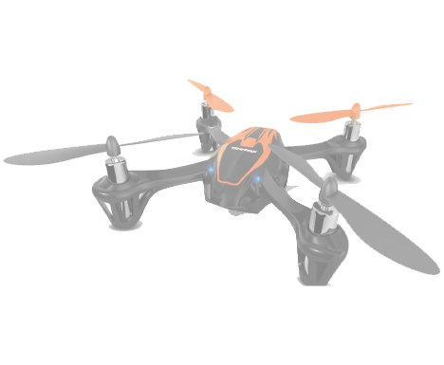

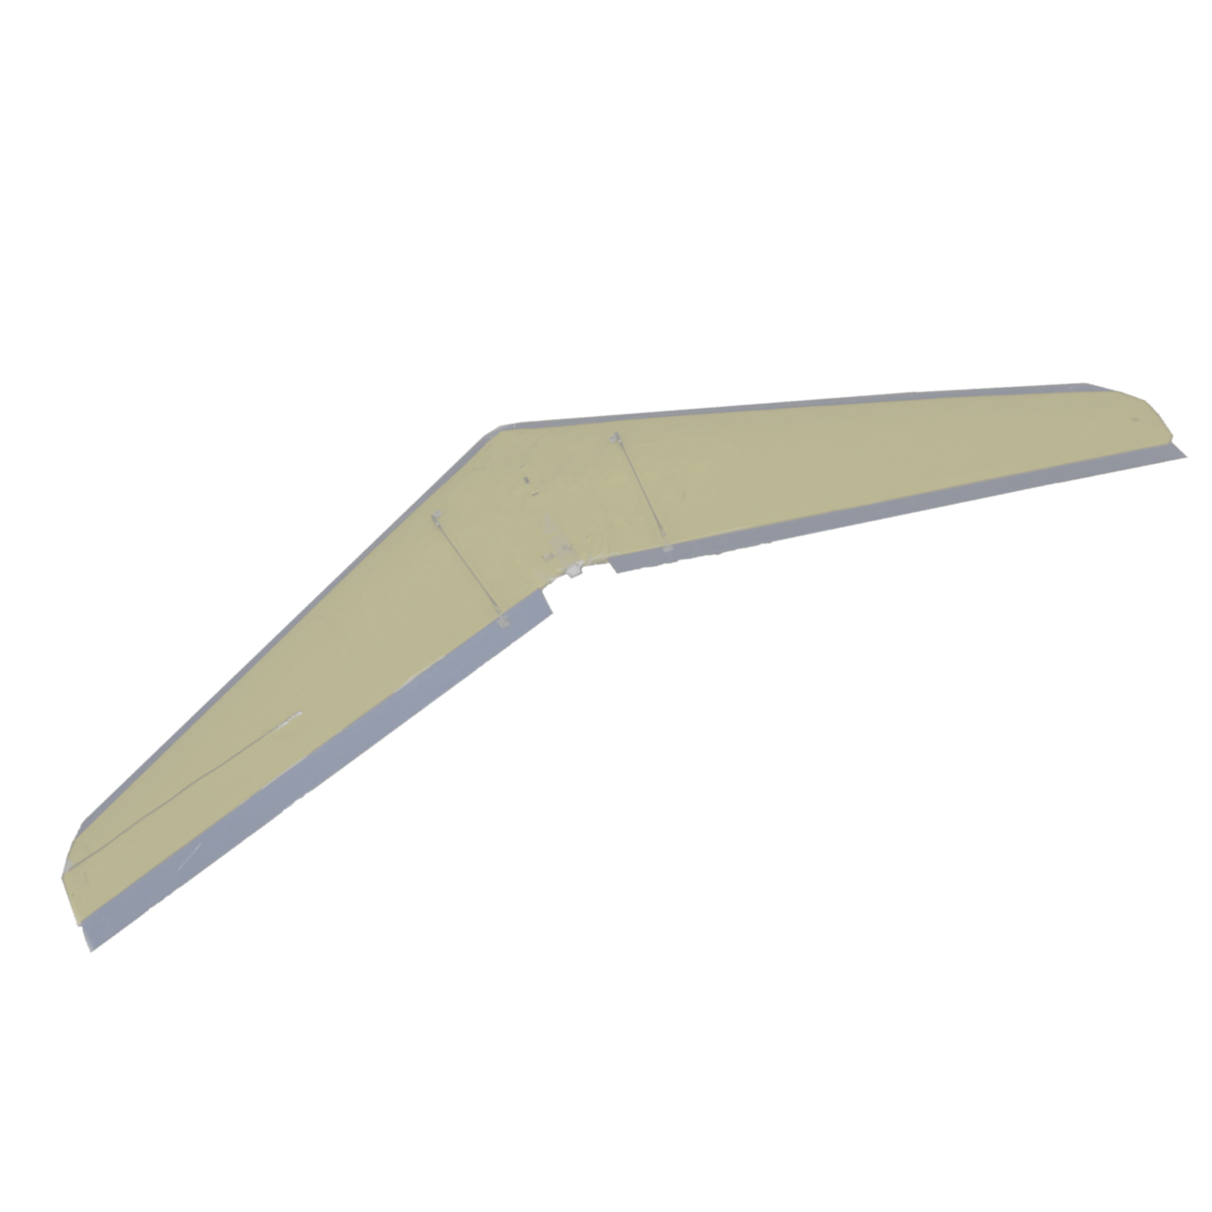

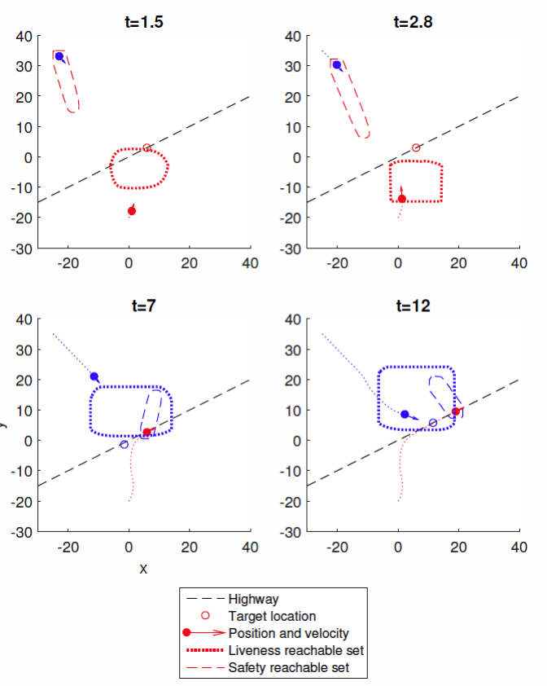
Safe Platooning of Unmanned Aerial Vehicles via Reachability
Mo Chen, Qie Hu, Casey Mackin, Jaime F. Fisac, Anayo K. Akametalu, Claire Tomlin
Electrical Engineering and Computer Sciences, UC Berkeley
Reachability
Safety and Liveness
Simulations
For a dynamical system with given
Dynamics
Target set of states
Reachable set
Set of states from which the system can be driven into the target set under worst-case disturbance
Guarantees both liveness and safety
Constructs optimal control
Intruder Vehicle
Reaction of a 4-vehicle platoon on a highway to an intruder.
Safety
Both vehicles must use safe controller on the boundary of safety reachable set
Liveness
Red vehicle: merges onto the highway to form a platoon
Blue vehicle: joins platoon
Move in a straight line towards target until inside liveness reachable set
Follow optimal control given by livenes reachable set
Leader vehicle (blue) unaffected by intruder. Remaining 3 vehicles (orange, yellow, purple) deviate to avoid collision with intruder, and return to highway when safe again.
Air Highways
Two Highways
Shortest paths from Concord to 9 other cities in the San Francisco Bay Area.
Platoons
Air highways minimize total cost: Cost of accidents, fuel, noise pollution, etc.
In ascending cost: Water, low population land, high population land, airports.
Resulting highway placement shows “trunks” and “branches”.
Cross-over of a 4-vehicle platoon on one highway with a 3-vehicle platoon on a second highway.
2 of the vehicles (orange, light blue) in the 4-vehicle platoon changes highway and join the 3-vehicle platoon. The remaining 2 vehicles (purple, dark blue) remain on the same highway.
Hybrid modes for vehicles in platoons.

